Slide 1


CS1010: Programming Methodology
UNIT 13
Call Stack
Live Q&A
https://pollev.com/jin

Slide 2
Unit 13: Call Stack
Stack Frame
Call Stack

Slide 3
Variables - redux
What is a variable?
It is used to hold a value (e.g., for input).
It is stored in the computer memory.
Why do we need to declare variables?
So that the computer can
Allocate some space in memory for the variable
Interpret the value of the variable accordingly
Where do we declare variables in most cases?
Mainly inside functions!

Slide 4
Function Call - redux
What is a function call?
A function call uses the function to performs the specified task.
What task is performed when the following main() function is called (by the operating system)?
Variable x is declared and initialized to 1
Variable y is declared.
int main()
{
long x = 1;
long y;
…
}

Slide 5
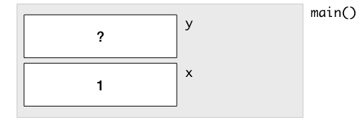
Stack Frame
What happens (in the memory) when you call this function…
A Stack Frame is created for main()
Some space is allocated to for variable x in the Stack Frame.
The value 1 is stored into this space.
Some space is allocated for variable y in the Stack Frame.
Stack Frame: The memory allocated to a function for storing parameters / variables (among other things).
int main()
{
long x = 1;
long y;
…
}

Slide 6
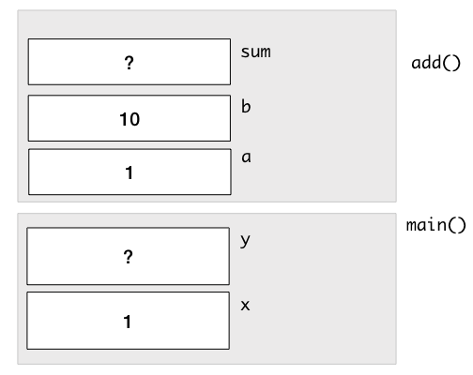
Call Stack
A Stack Frame is added to the Call Stack when a function is called with the values of the arguments copied over.
long add(long a, long b) {
long sum;
sum = a + b;
return sum;
}
int main()
{
long x = 1;
long y;
y = add(x, 10);
…
}
a.k.a. Call By Value
The Call Stack after sum is declared in add().

Slide 7

Call Stack
A Stack Frame is added to the Call Stack when a function is called with the values of the arguments copied over.
long add(long a, long b) {
long sum;
sum = a + b;
return sum;
}
int main()
{
long x = 1;
long y;
y = add(x, 10);
…
}
The Call Stack after sum is computed in add().

Slide 8
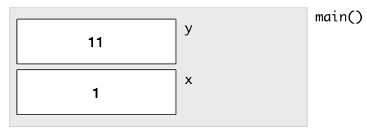
Call Stack
A Stack Frame is removed from the Call Stack after the function has completed.
long add(long a, long b) {
long sum;
sum = a + b;
return sum;
}
int main()
{
long x = 1;
long y;
y = add(x, 10);
…
}
The Call Stack after add() has been completed.

Slide 9
Call Stack
Each Stack Frame is independent from another.
long add(long a, long b) {
long x;
x = a + b;
return x;
}
int main()
{
long x = 1;
long y;
y = add(x, 10);
…
}
The Call Stack after x is computed in add().

Slide 10
Common Mistake
What happens when you call factorial(5) with the following function?
long factorial(long n)
{
long answer;
answer = n * factorial(n - 1);
return answer;
}
Infinite recursion.
May cause stack overflow as signaled by segmentation fault or crashing…

